Slide 1

Road Sign's Classification
- Using CNN
Akilan J DADS - Nov 2024

Slide 2
Overview
Objective:
Build a CNN model to identify and classify road signs into 30 different categories. Improve road safety systems and assist self-driving cars by recognizing traffic signs accurately and quickly.
Method:
Collected and processed labeled road sign images.
Trained a deep learning model using image preprocessing, augmentation, and model tuning.
Designed a user-friendly web app using Streamlit for demo and testing.

Slide 3
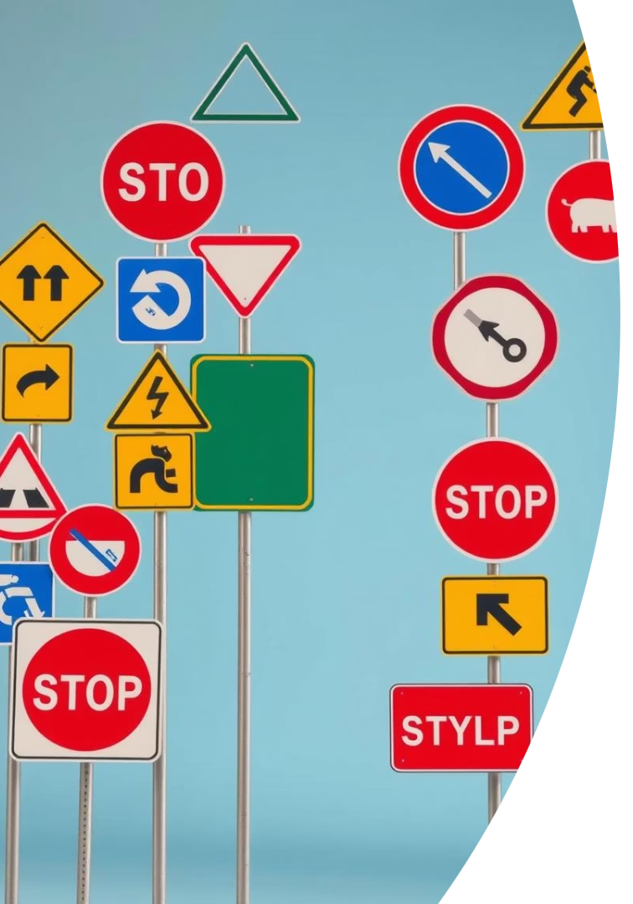



About Dataset
Road Sign Images
30 Road Sign Classes
Data: 743 Test: 285
Diverse images for classification
Categories include speed limits, directions, warnings/stop signs
Dataset Split
Defined distribution for training, validation and testing

Slide 4




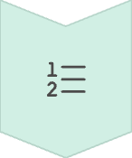
Data Preprocessing
Resize Images
Load and resize image, uniform image size
(64 × 64)
Normalize Pixels
Scale data for better training
(0–255 to 0–1)
Split Dataset
Defined distribution for training, validation and testing
Encode Labels
Integers or one-hot vectors

Slide 5
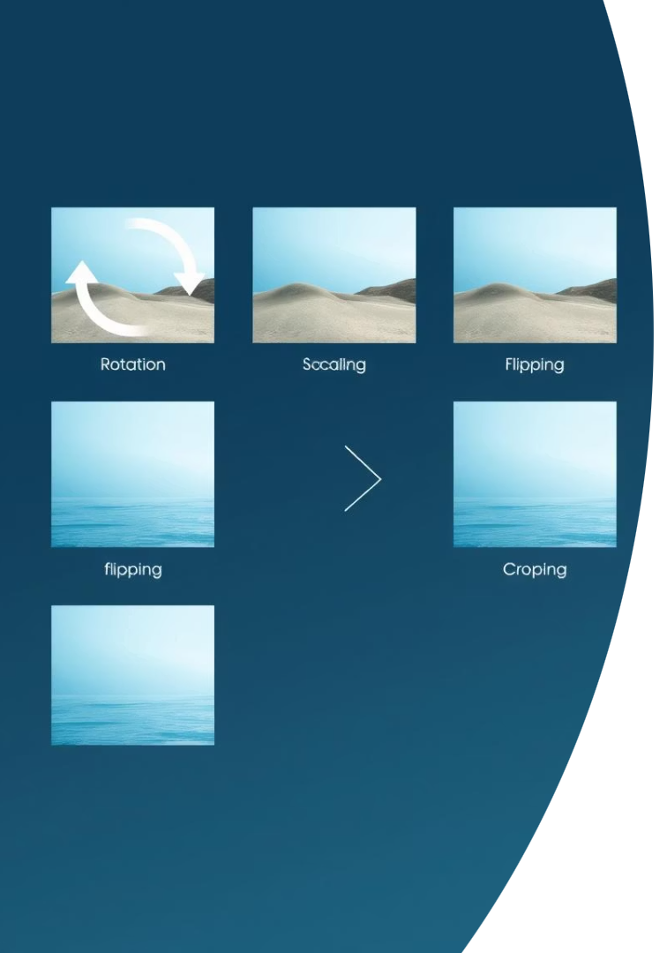




Enhancing Data with Augmentation
Rotation
Scaling
Flipping
Cropping
Data augmentation techniques increase dataset diversity and model robustness, making the model generalize better to unseen variations.

Slide 6
Building the CNN Architecture
Input Layer
Define input shape (e.g., 64x64x3 RGB)
Convolutional Layers
Extract features from images
Pooling Layers
Max-pooling for downsampling feature maps
Fully Connected Layers
Dense layers for classification
Activation Functions
ReLU for hidden layers, softmax for output

Slide 7
Model Compilation and Training
Compilation
Training
Optimizer selection (Adam, SGD)
Data split: 70% train, 15% validation, 15% test
Loss function (categorical crossentropy)
Monitor validation performance
Evaluation metrics (accuracy)
Early stopping to prevent overfitting
Checkpoints for model generalization

Slide 8
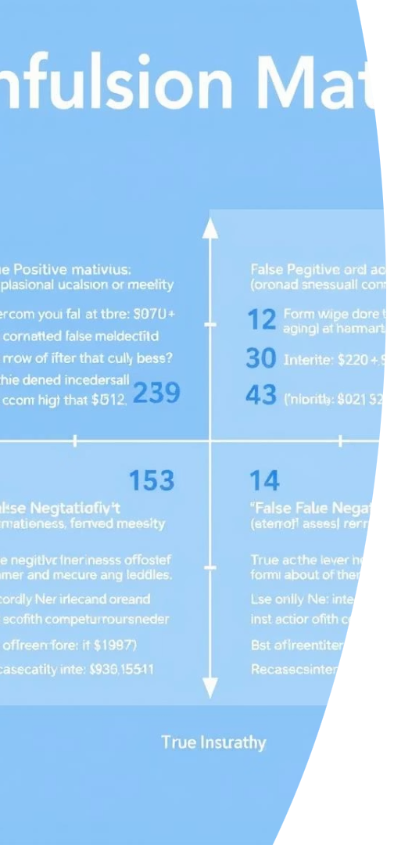
Model Evaluation and Real-World Testing
Evaluate Performance
Visualize Performance
Use accuracy, precision, recall, F1-score on test set
Confusion matrices for class-specific performance
Test with New Images
Verify real-world performance on unseen data

Slide 9




Hyperparameter Tuning
Learning Rate
1
Number of Filters
Optimize filter count and kernel size
2
Experiment with kernel sizes
Dropout
4
Architectural Changes
3
Improve model performance
Add layers, adjust neurons

Slide 10
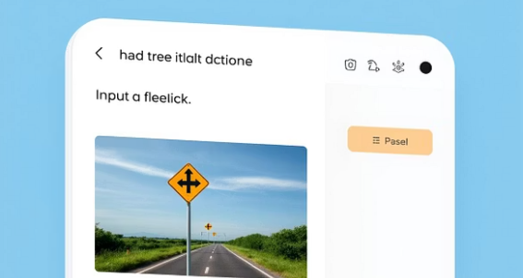
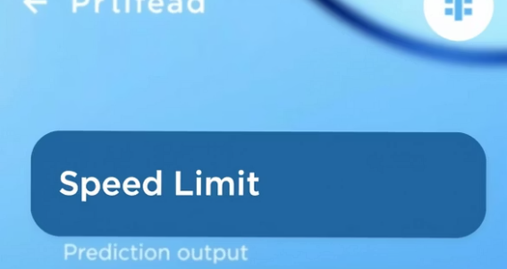

Interactive UI with Streamlit
1
Upload Images
Users can easily upload new road sign images to the Streamlit UI.
2
Instant Predictions
The trained model will instantly analyze the uploaded images and provide class predictions.
Accuracy Insights
3
The UI will display the model's accuracy and confidence levels for each prediction, allowing users to visually inspect performance.

Slide 11
Conclusion
Achievements
Future Work
Deployment
Developed an accurate, lightweight model with a user-friendly interface.
Retrain with real-world data and integrate with simulations.
Quantization for optimized mobile deployment.

